Slide 1
ELEMENTARY STATISTICS, BLUMAN
TI Graphing Calculator – Mean and Standard Deviation for a Discrete Random Variable
© 2019 McGraw-Hill Education. All rights reserved. Authorized only for instructor use in the classroom. No reproduction or further distribution permitted without the prior written consent of McGraw-Hill Education.

Slide 2
Objectives for this PowerPoint
Find the mean and standard deviation for a discrete random variable using the TI Graphing Calculator.

Slide 3
Example (1)
A county vehicle inspection bureau recorded the following probabilities for the number of vehicles inspected per day with brakes that do not meet he minimum safety standard.
The table contains the number of vehicles with unsafe breaks from 0 to 5 and their respected probabilities.
Number of Vehicles X | 0 | 1 | 2 | 3 | 4 | 5
Probability P(X) | 0.4 | 0.2 | 0.15 | 0.1 | 0.1 | 0.05

Slide 4
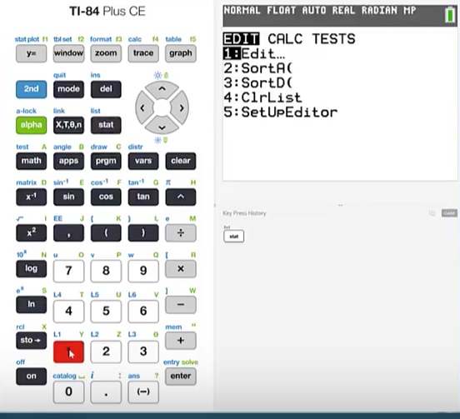
Example (2)
Press stat
Press 1

Slide 5
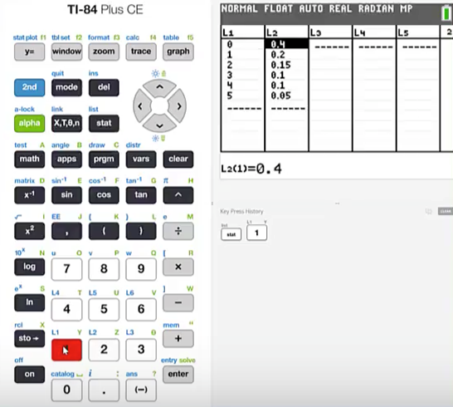
Example (3)
Type the values of the random variable into List 1 and the respective probabilities into List 2.
It is important that the corresponding values of the random variable and the probabilities are adjacent to each other in this list.

Slide 6
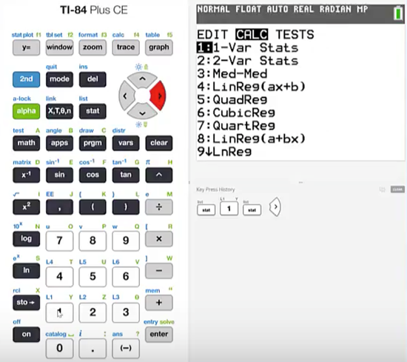
Example (4)
Press stat
Cursor over to CALC
Press 1 for 1 Variable Statistics

Slide 7
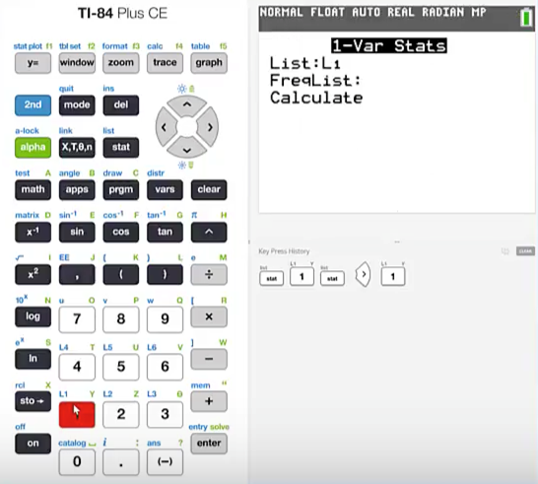
Example (5)
We entered the values of the random variable into List 1.
Press 2nd 1 to specify List 1

Slide 8
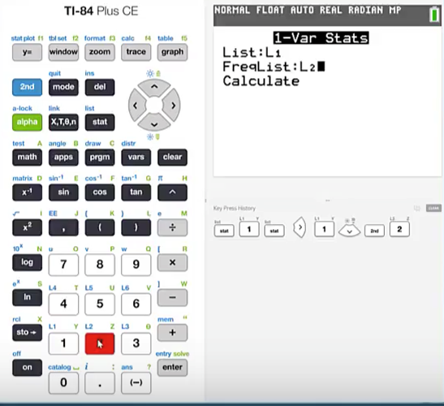
Example (6)
Cursor down
The Frequency List is the list that contains the corresponding probabilities.
We entered those probabilities into List 2.
Press 2nd 2

Slide 9
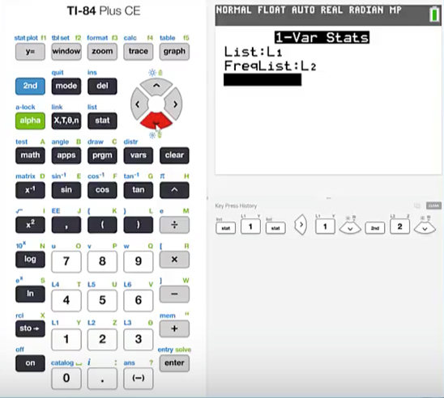
Example (7)
Cursor down
Highlight Calculate
Press enter

Slide 10
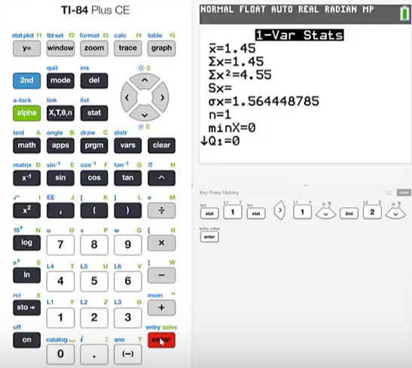
Example (8)
The TI Graphing Calculator then gives us the mean as 1.45 and the standard deviation as 1.56444878.

Slide 11
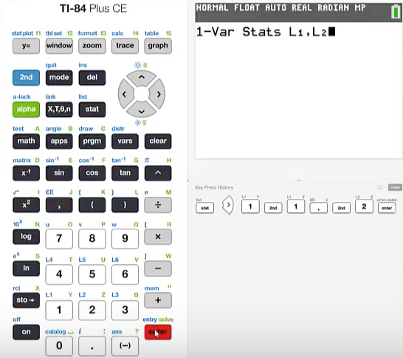
Example (9)
If you are using a calculator that does not utilize the Stats Wizard then you need to make sure that the syntax is correct.
When the screen presents the 1 variable stat function you press 2nd 1 (List 1)
comma
2nd 2 (List 2)
Press enter

Slide 12
Rounding Rule
Remember the rounding rule for the mean and the rounding rule for the standard deviation are to round to one more decimal place than occurs in the raw data.
Number of Vehicles X | 0 | 1 | 2 | 3 | 4 | 5
Probability P(X) | 0.4 | 0.2 | 0.15 | 0.1 | 0.1 | 0.05
Our raw data are the numbers of vehicles. Which are whole numbers. We should round to one more decimal place.
We will report the mean as 1.5 and the standard deviation as 1.6.

Slide 13
Summary
In this PowerPoint we learned out to find the mean and standard deviation for a discrete random variable using the TI Graphing Calculator.

